Slide 1

ByteBuddies
CINEMAPRO
Team Members
Saksham Purwal
Gourav Goyal
Nandini Arora
Gunnika Arora
Gauri Kashyap

Slide 2
ByteBuddies
OVERVIEW
Python-based Movie Ticket Booking System with GUI.
Simple and easy movie ticket booking.
Users can select movies, seats, and enter details.
Checks seat availability and generates PDF tickets.
Demonstrates practical use of Python and Tkinter.

Slide 3
ByteBuddies
Features of the System
Browse and select movies from the available list.
Check seat availability before booking.
Book multiple tickets in a single transaction.
Automatically generate and save PDF tickets.
View booking history within the application.
Simple navigation between screens
(Home, Booking, History, About)

Slide 4
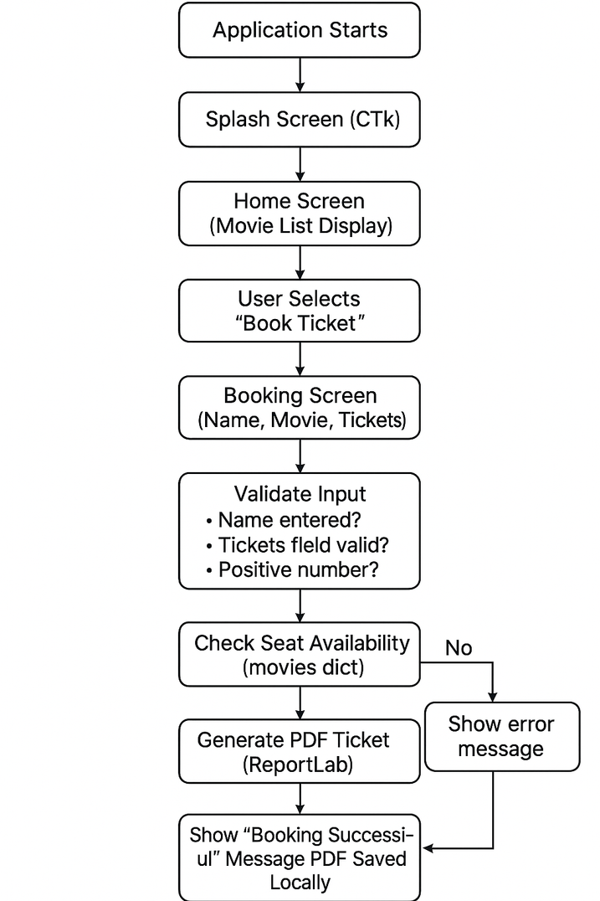



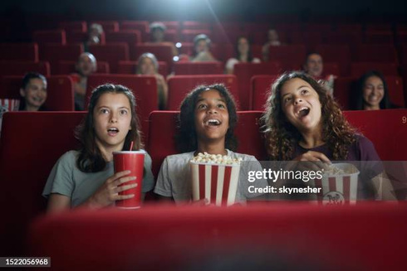
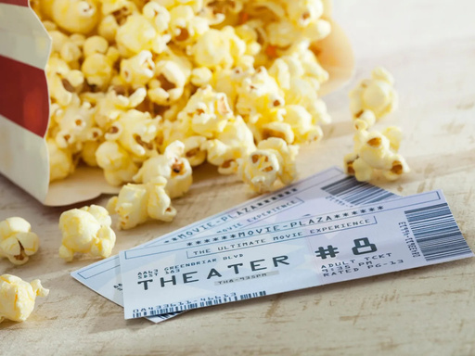
System WorkFlow

Slide 5




ByteBuddies
Technology stack
Python
TKinter
SQLite
ReportLab

Slide 6
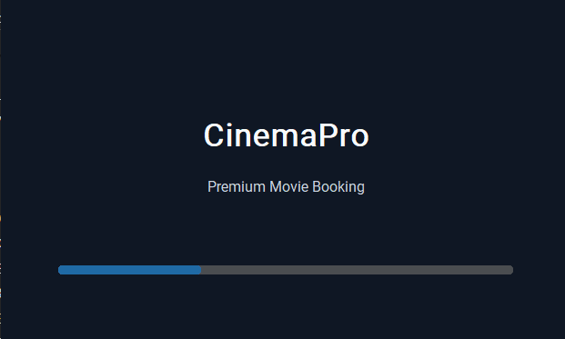
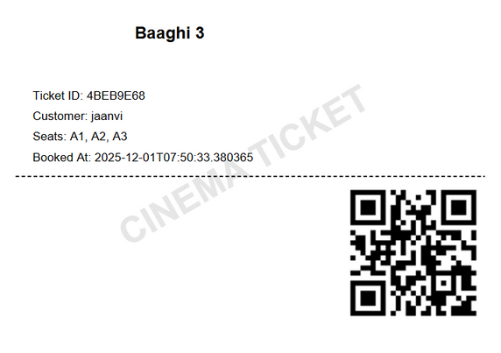
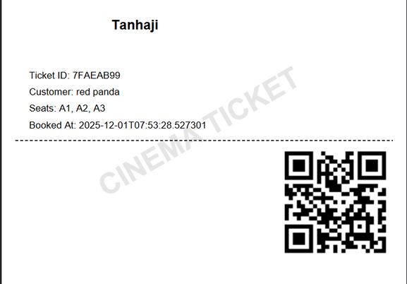
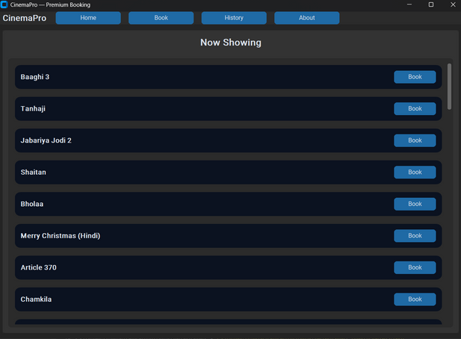
ByteBuddies
OUTPUT

Slide 7
ByteBuddies
Conclusion
The project successfully demonstrates a functional movie ticket booking system using Python.
Provides a smooth user experience with an interactive GUI and modern interface.
Ticket generation through PDF creation, making the process efficient and realistic.
Can be further enhanced with payment integration, seat layout selection, and online database support.

Slide 8
THANK YOU

